Slide 1
Rotary Basics
September 13, 2014

Slide 2
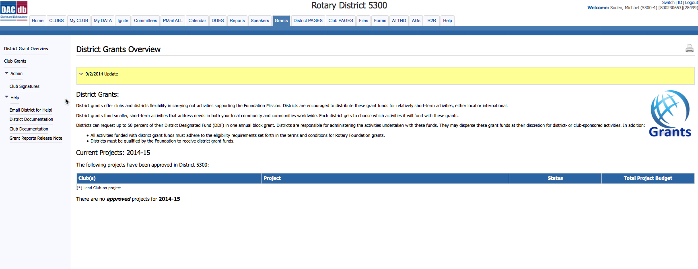
Grant Module

Slide 3
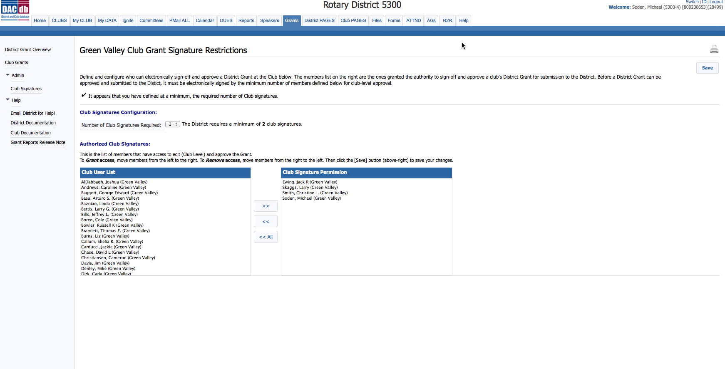
Grant Signatures

Slide 4
Grant Club Grants

Slide 5
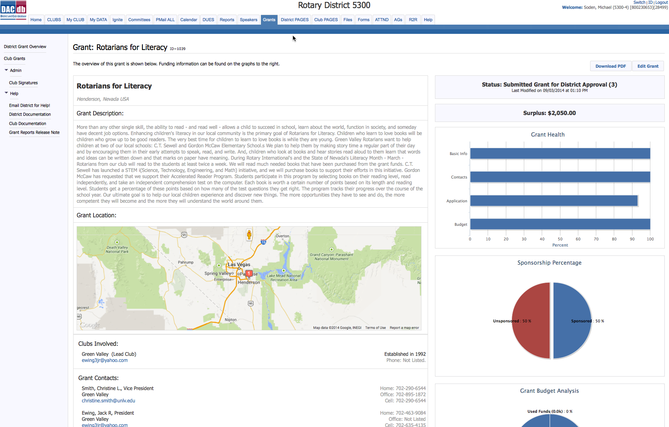
Grant Dashboard

Slide 6
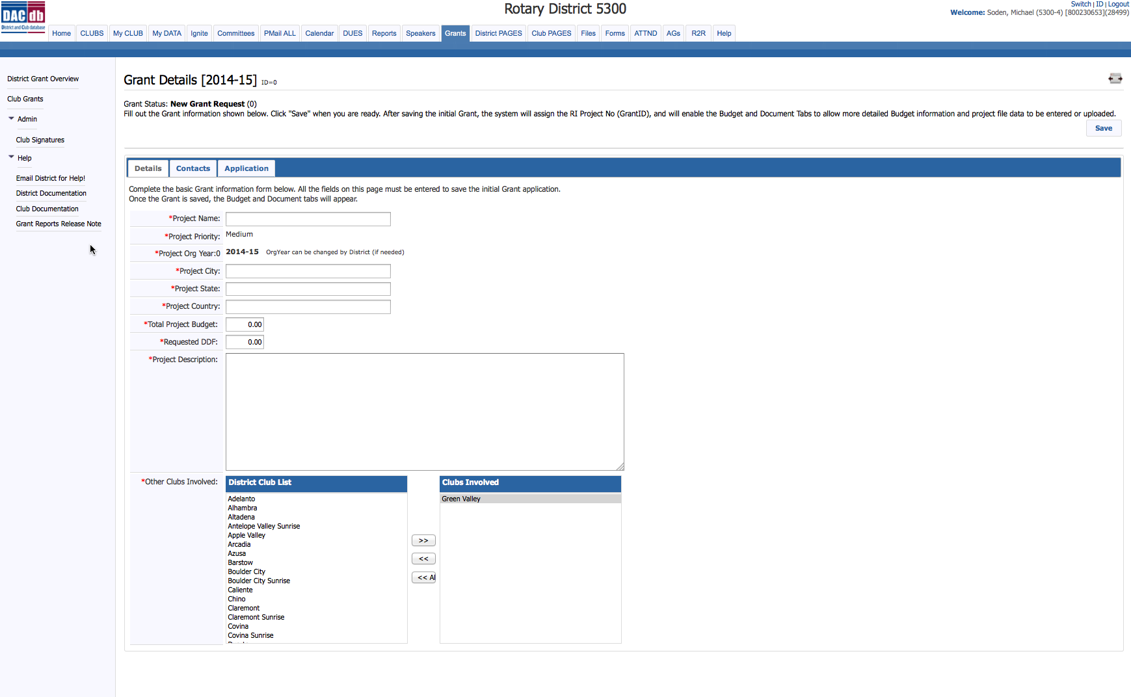
Grant Details

Slide 7
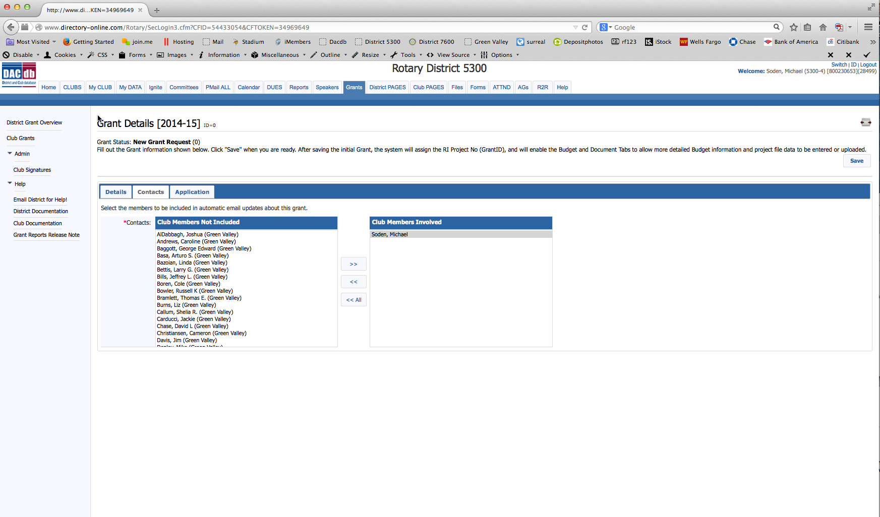
Grant Contacts

Slide 8
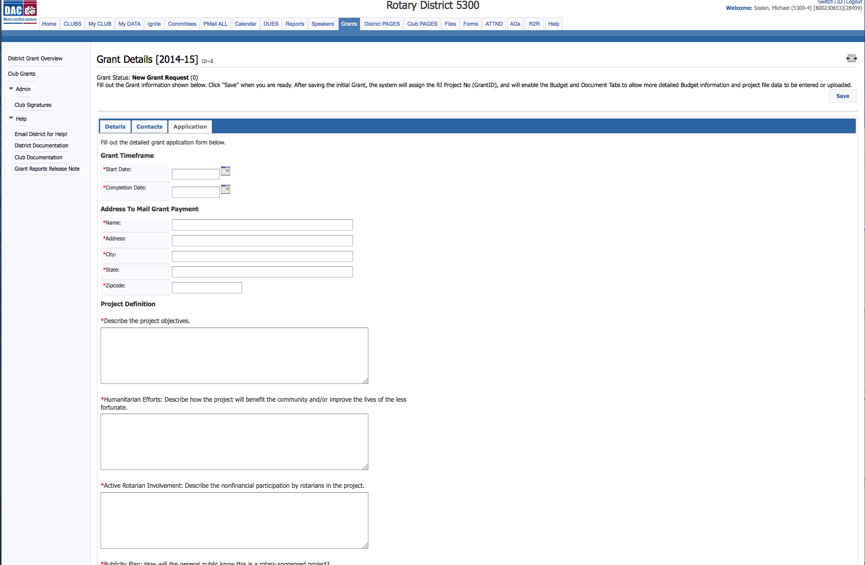
Grant application

Slide 9
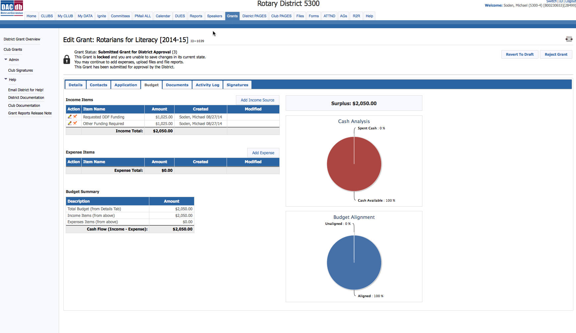
Grant Budget

Slide 10
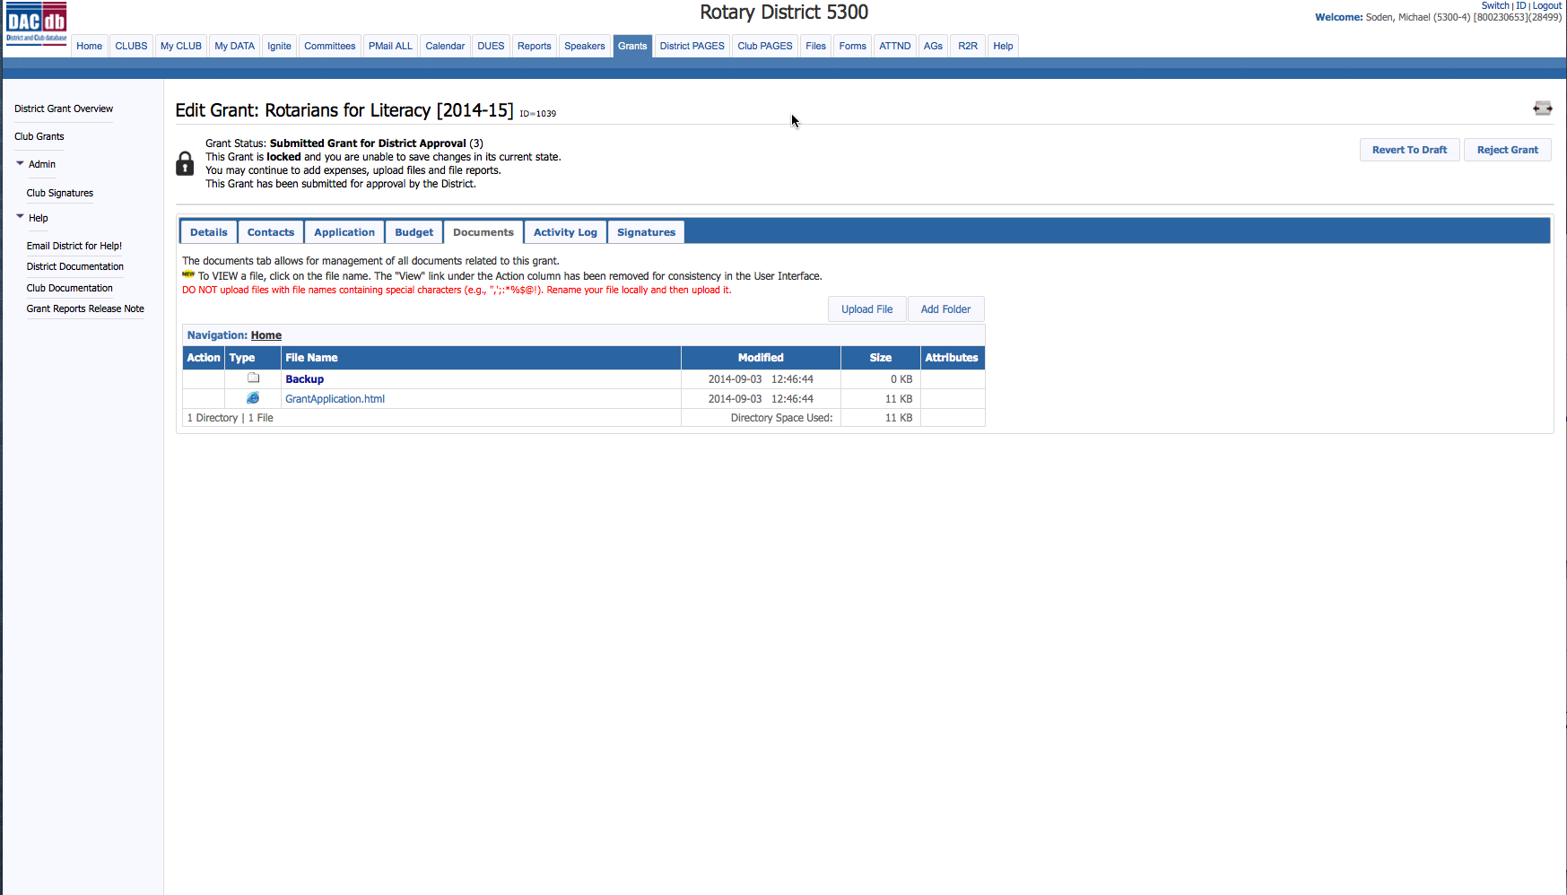
Grant Documents

Slide 11
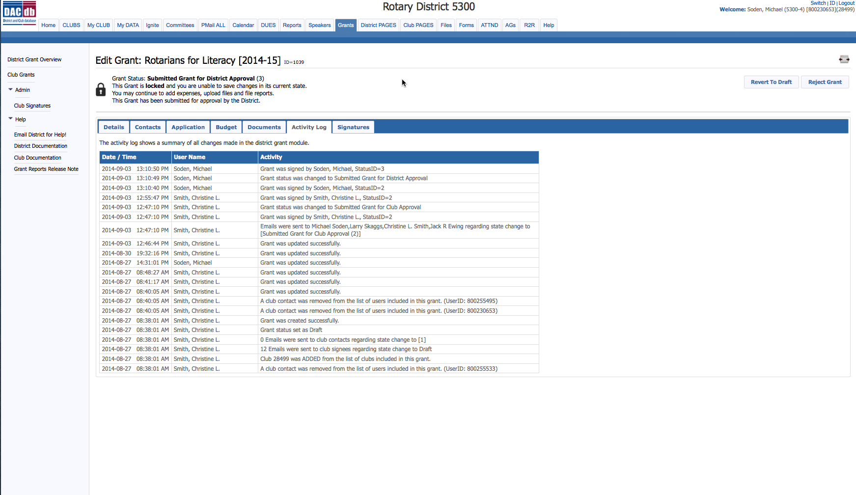
Grant Activity Log

Slide 12
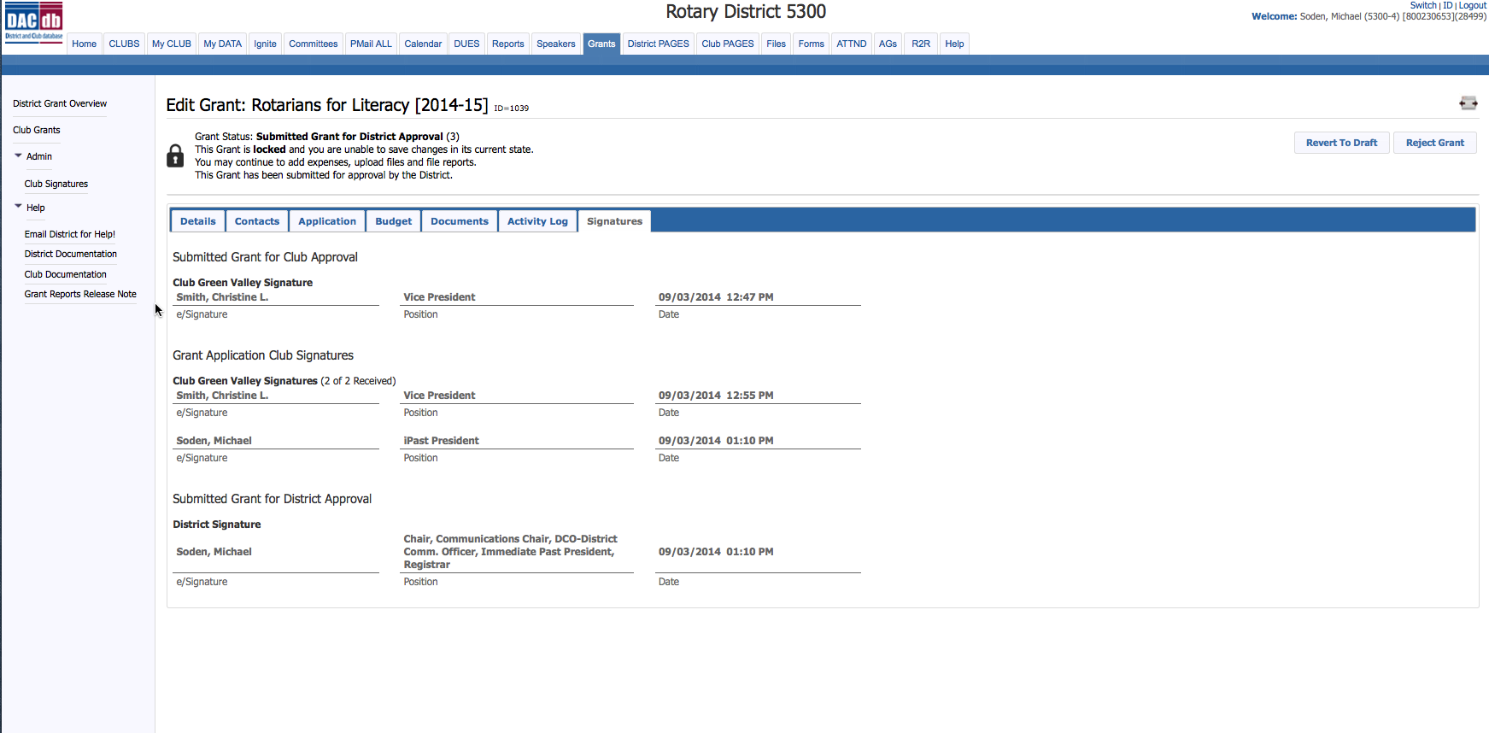
Grant Signature

