Slide 1
George R. Hensel
Ethics Essay Contest

Slide 2
The contest is held on two competition levels:
First at the local Rotary club level, and second at the District level.
The student who wins first place at the Club level automatically advances to the District level.

Slide 3
Purpose
Promoting the importance of ethics
Creating a venue for high school students to express their views
Giving recognition to outstanding writing skills
Giving Rotary a higher visibility within your community

Slide 4
Unique to District 5300
$100 Club participation fee
District cash prizes to winners
District cash prizes to winning student’s teacher
Modest responsibilities for each Club under Vocational Avenue of Service

Slide 5
District Level Awards
$3,000
First Place
$1,000 to winner’s teacher
$500 each
to 3 Runner-Ups
$200 to their teachers

Slide 6
Who Can Participate?
Open to all high school students from grades 9 – 12 (as of March 31, 2024)
Living in or enrolled in any public or private high school in District 5300

Slide 7
Why Participate?
Mental Health of Students
Recognize local students
Highlight Rotary’s commitment to youth

Slide 8
Procedures
Locate your local High Schools
Talk to the high school counselor, principal, or English Department Chairperson
Define due dates and requirements
Judge the Club level essays
Submit winning essay to: districtessaycontest@mtbrotary.org

Slide 9
Club Level Judging
Invite school personnel, elected officials, friends of the Club, potential members to judge
3 judges per 10 essays is optimal

Slide 10
Rules
Must contain no more than 1,000 or less than 800 words
12 point standard font
Original, unpublished work
Club winners must be submitted to: districtessaycontest@mtbrotary.org by April 24, 2024.
The essay may not be submitted to another club

Slide 11
Judging Criteria
Content = 40%
Clarity of message
Presentation
Creativity = 40%
Style
Originality
Composition = 20%
Grammar
Spelling
Structure

Slide 12
Time Line
Club Confirmation and Registration fees
Must be submitted to District 5300 by
December 31, 2024
Student Essay Entry
Must be submitted to the local Club by
April 1, 2024
Club Level Winner
Must be submitted to the District by
April 24, 2024
To: districtessaycontest@mtbrotary.org

Slide 13
Winners Awarded at
District Assembly Saturday, May 18, 2024 Transportation of the First Place winning student to the District Assembly is local Club’s responsibility.

Slide 14
Everything you need is
on 5300 District website
Information Brochure
Letter to School Principal
Flyer
Entry Forms
Judges Score Cards
Award Certificates
PowerPoint

Slide 15
District Winning Essay
and Runner-ups will be posted on the
District 5300 website

Slide 16
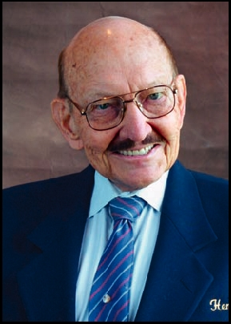
George R. Hensel
1924-2012
George, the founder of California Driving School, was an exemplary Rotarian with a 45-year record of perfect attendance. A real model of the Horatio Alger myth, going from sleeping on park benches during the Depression, through the Merchant Marines, to a Ph.D. in business and an impressive record of philanthropy giving millions of dollars to the community and Rotary. His legacy continues through the Rotary
George Hensel Ethics Essay Contest.

Slide 17
Service Above Self
Rotary International District 5300
George Hensel Ethics Essay Contest
District Chairperson
Manuel “Manny” Franco, Montebello Club
(213) 716-3059
manuel.franco@me.com

