Slide 1

PARENT/STUDENT ORIENTATION
Rotary international, District 5300
Teen Leadership Camp
December 6– 8, 2024
Camp Cedar Crest
Running springs, CA

Slide 2
District Governor –Michael Driebe , Rotary Club of San Marino
TLC Chair – Eric Threeton, Rotary Club Las Vegas Southwest
Transportation Coordinator – Celeste Kelley, Rotary Club of Pomona
Facilitator Coordinator – Rebecca Fritz, Rotary Club of Las Vegas Redrock,
Registrar – Raghada Khoury, Rotary Club of West Covina Caue Based
Senior Counselors Coordinator - Erica Yang, Rotaty Club of Walnut Valley
Additional Committee Members, Continent Leaders, Facilitators, Senior Counselors, Photographers & Lab Leaders – All Rotarian volunteers

Slide 3
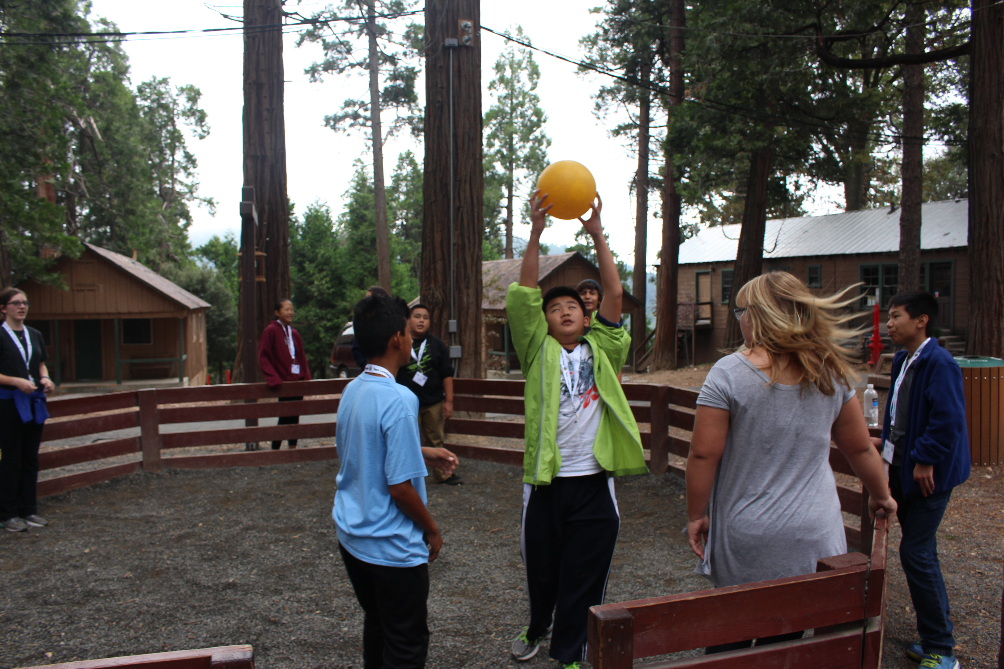
Tonight's agenda
WHAT TO EXPECT
Welcome Students & Parents
Introductions of Rotarians
Goals of TLC
What to Expect at TLC
What to Bring to TLC
What Not to Bring to TLC
Q&A

Slide 4
Welcome to t.l.c.
What Is TLC
  TLC is a 3-day intensive leadership training program for outstanding 8th graders, done under the supervision and care of capable, responsible and inspirational volunteer leaders.
  The program is sponsored and paid for by the Rotary Clubs of District 5300. You will meet Rotary decision-makers from your community and learn about other Rotary programs for young people.
  The Teen Leadership Camp experience prepares young people to be leaders in their community, profession and other facets of everyday life
  Students will interact and participate in activities with over 200 peers from areas throughout our District which encompasses Clubs from the Eastern Los Angeles area, Inland Empire, High Desert and Southern Nevada.

Slide 5
Welcome to t.l.c.
What do we do at camp?
  Get ready for three days of excitement! We have a program that includes inspirational speakers, teambuilding activities, small group discussions, and of course- building relationships with peers from around our district!

Slide 6
introductions
TLC VOLUNTEERS
ENTER YOUR PRESENTER INFO HERE
Who Will Be at Camp?
District 5300 TLC Committee
20 Rotarian Advisors
20 RYLA Alumni (Senior Counselor Advisors)
10 Lab Leaders
Numerous other positions.

Slide 7
GOALS OF TLC
WHAT SHOULD YOU GAIN
Offer young people the opportunity to debate issues of professional responsibility and human relations, and to improve leadership skills
Reinforce and provide recognition for efforts, accomplishments, skills and potential as leaders
Develop an understanding of Rotary among youth participants
TLC places an emphasis on:
  Development of personal skills
  Development of leadership skills
  Improving self confidence
  Gaining exposure to a variety of issues and people
  Improving career skills and knowledge
  Meeting and learning from community leaders and mentors
Notes:
RYLA will help you:
• Develop leadership skills
• Increase self-confidence
• Gain exposure to
a variety of issues and people
• Improve career skills and knowledge
• Meet community leaders and members

Slide 8
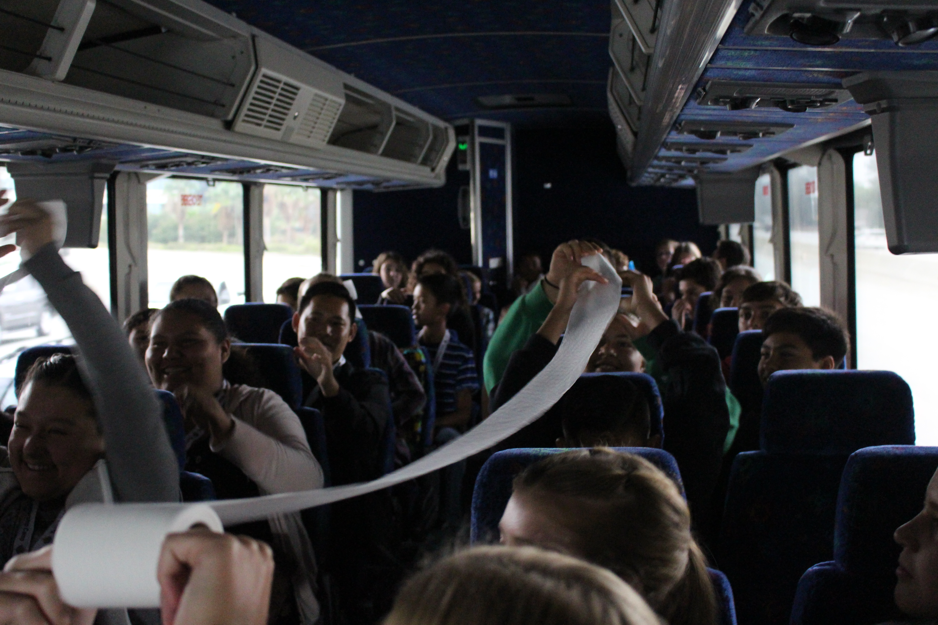
WHAT TO EXPECT
DAY ONE
A very early start to your day: You should be at your bus pickup locations by the time listed on your What To Bring/Bus Info papers.
Every participant MUST ride the bus to and from the camp. Absolutely no exceptions will be made.
The buses do not stop. There is no restrooms on the California buses. Bring water / snacks.
Arrive at TLC mid-morning
Meet your Group, Facilitator and Rotary Leader
Lights out at 10:00 pm
Notes:
RYLA will help you:
• Develop leadership skills
• Increase self-confidence
• Gain exposure to
a variety of issues and people
• Improve career skills and knowledge
• Meet community leaders and members

Slide 9
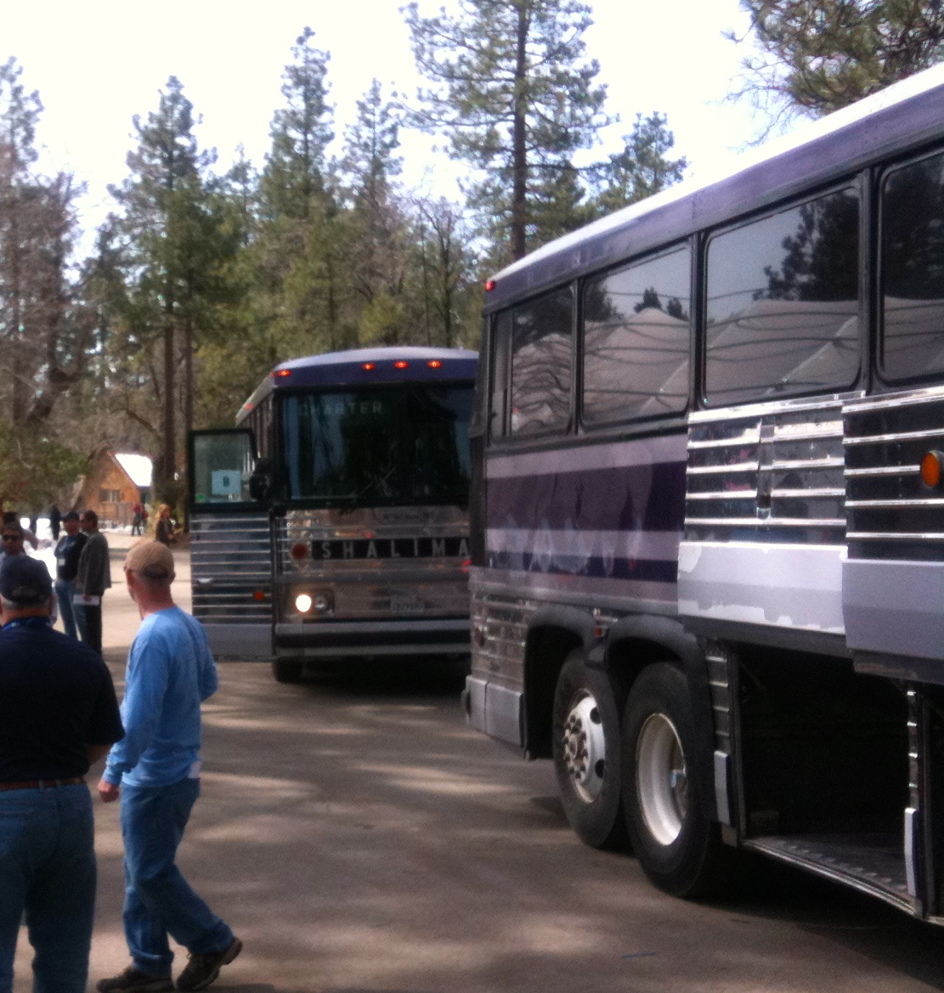
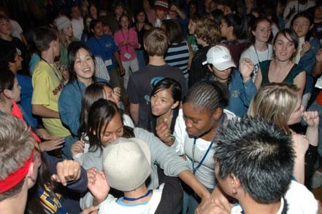
WHAT TO EXPECT
DAY ONE (continued)
Expect to have to carry your luggage, as well as your sleeping bag and pillow. Pack lightly
Prepare for all kinds of weather
You will sleep in dorms with other students
Wear your name tag at all times hang at the foot of your bed at night
You will not be grouped with your hometown friends

Slide 10
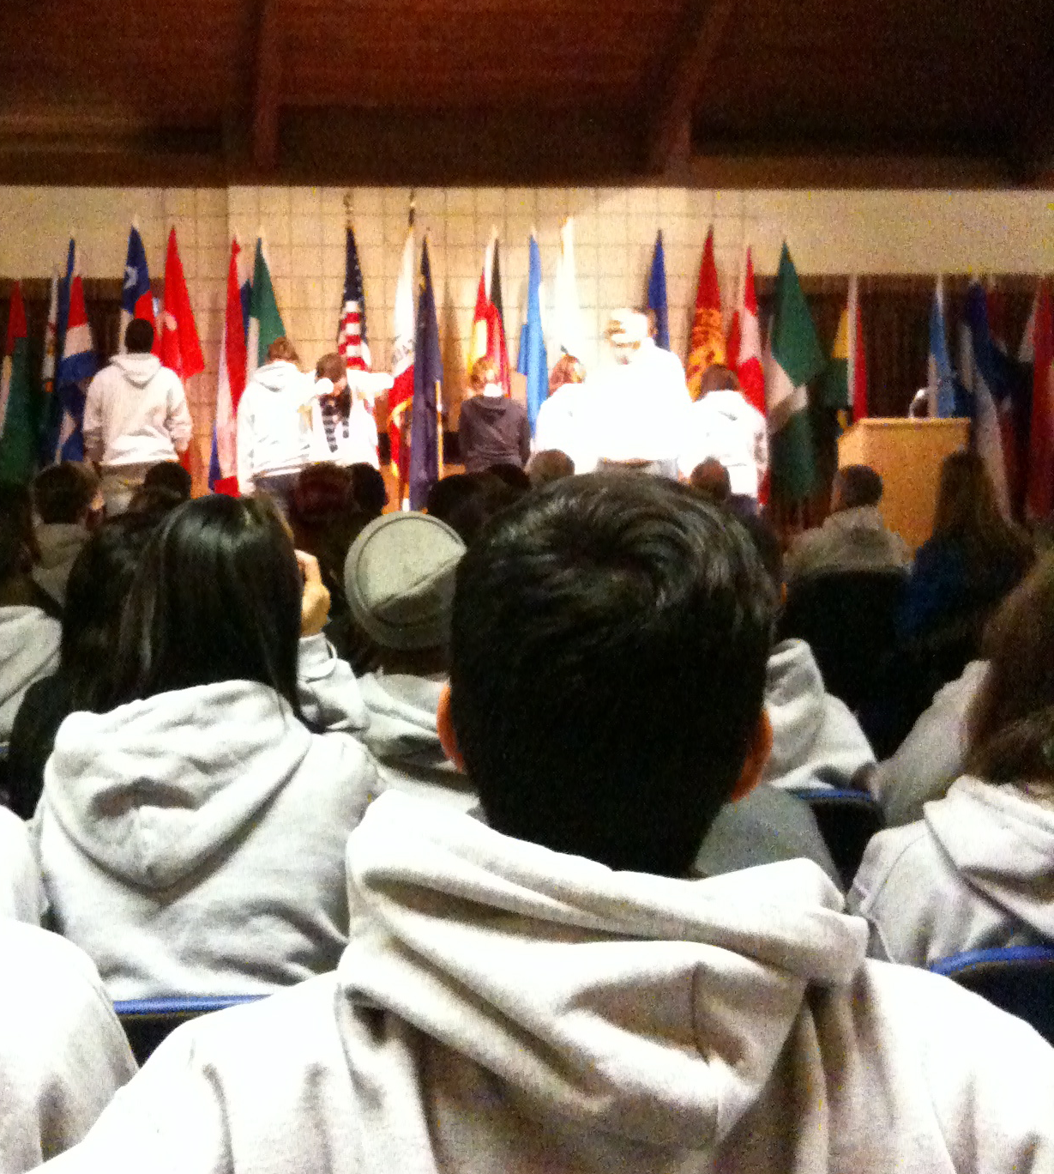
WHAT TO EXPECT
LARGE GROUP SESSION & LEADERSHIP LABS
General sessions are large group meetings with great speakers
Students host the General sessions
Smaller group labs will challenge you, reward you, frustrate you and teach you more about yourselves

Slide 11
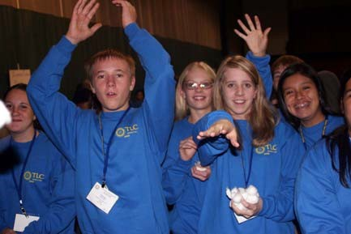
WHAT TO EXPECT
MEALS & SOCIAL ACTIVITIES
Opportunities to meet new people and make new friends.
Mealtimes will provide an opportunity to mix with students from other cities and meet other facilitators
Great food served family style
Fellowship Activities

Slide 12
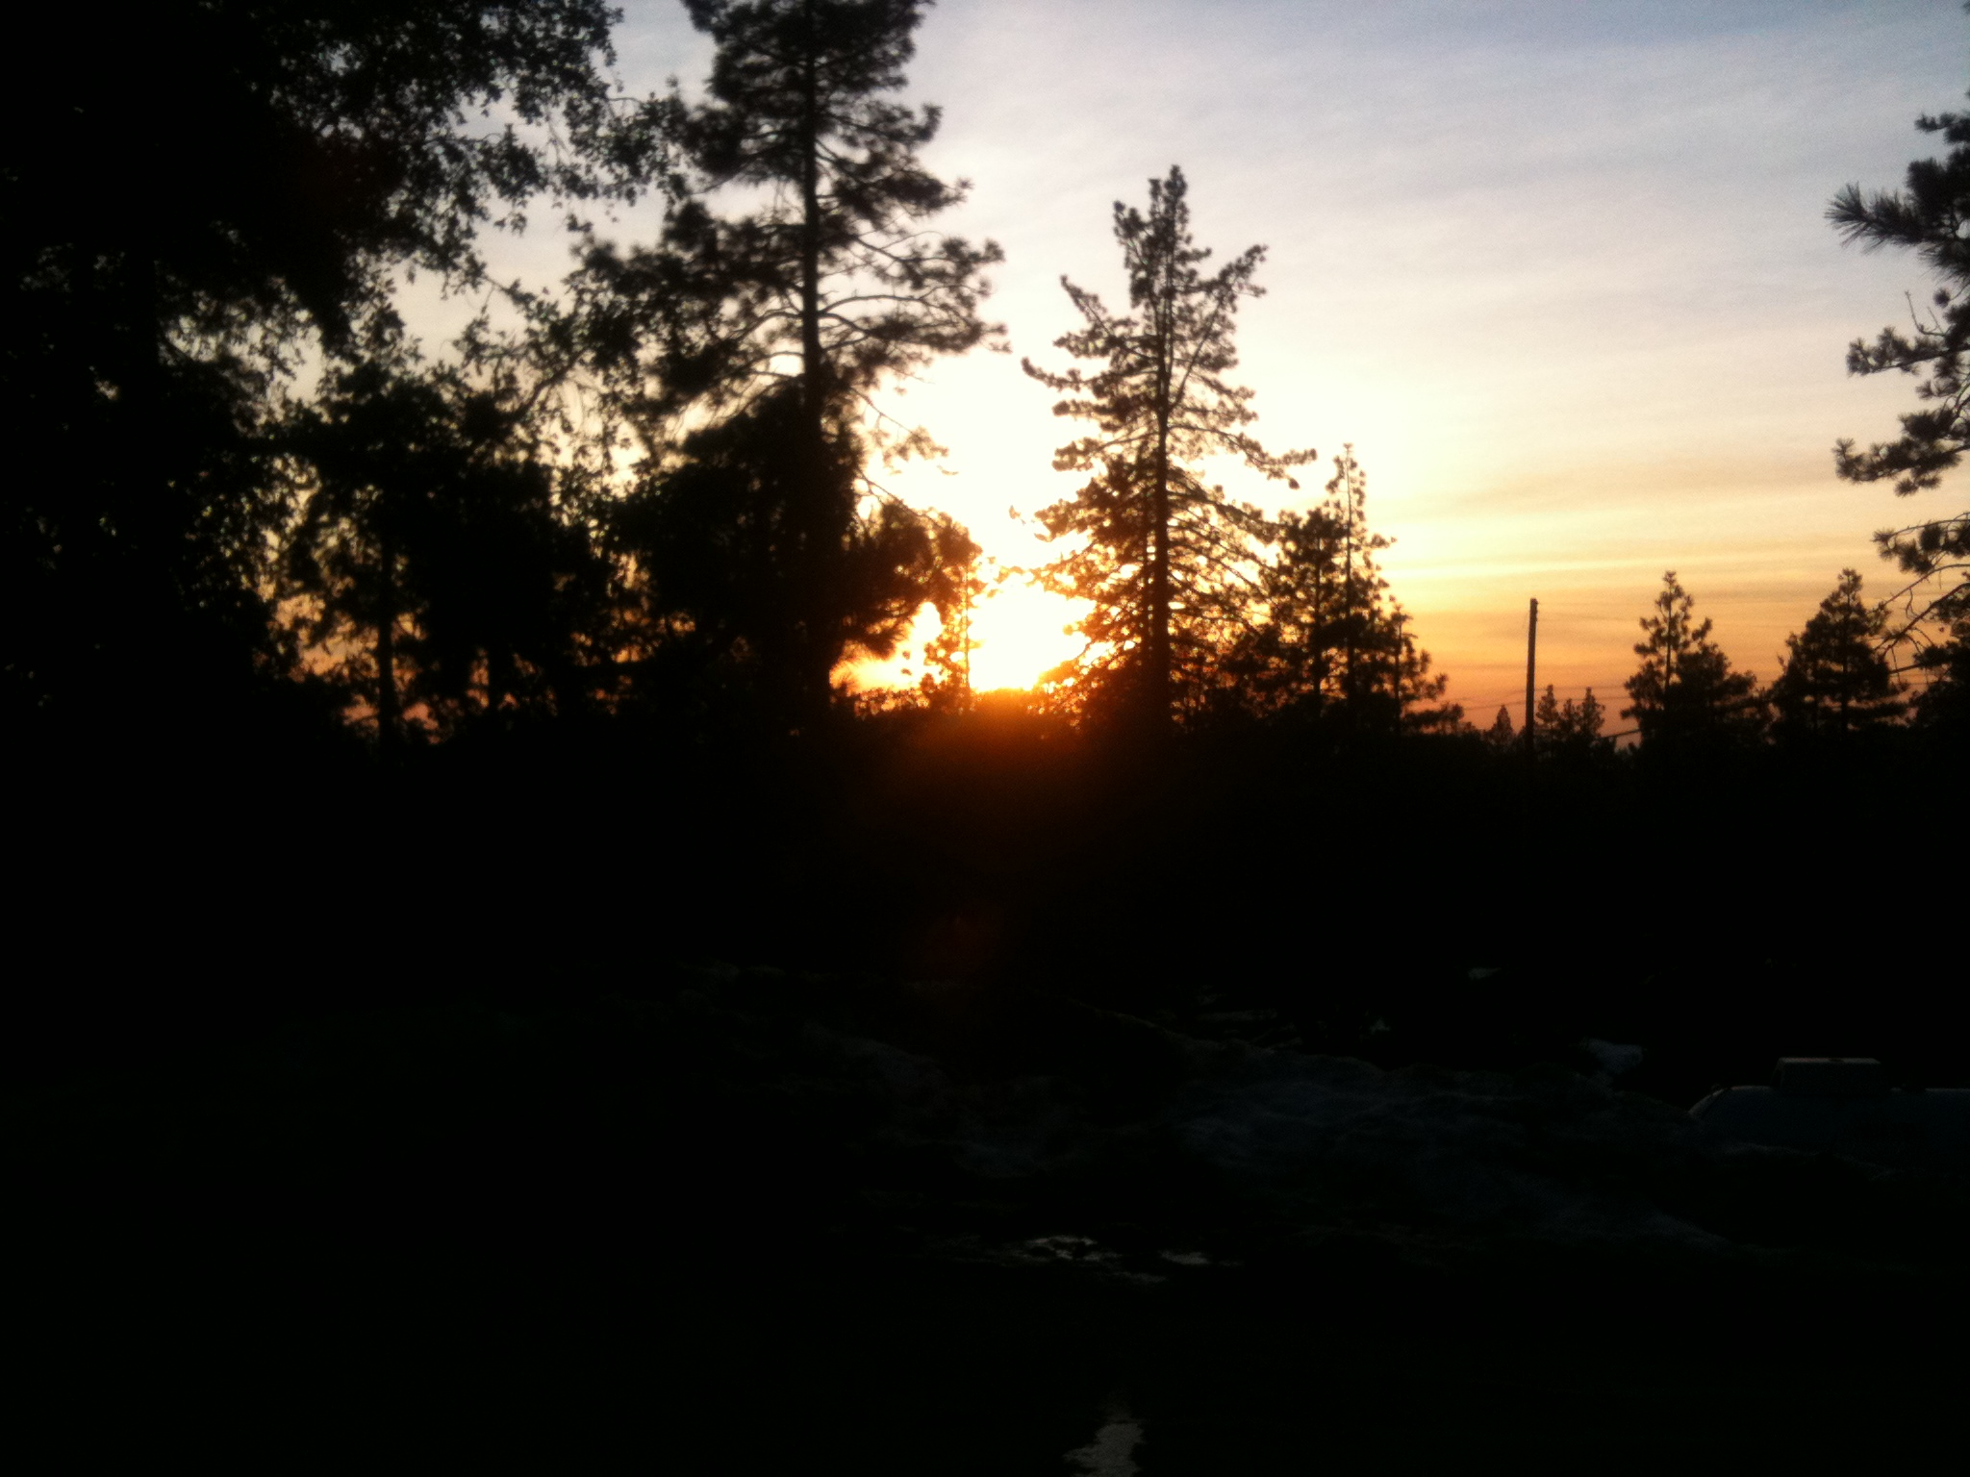
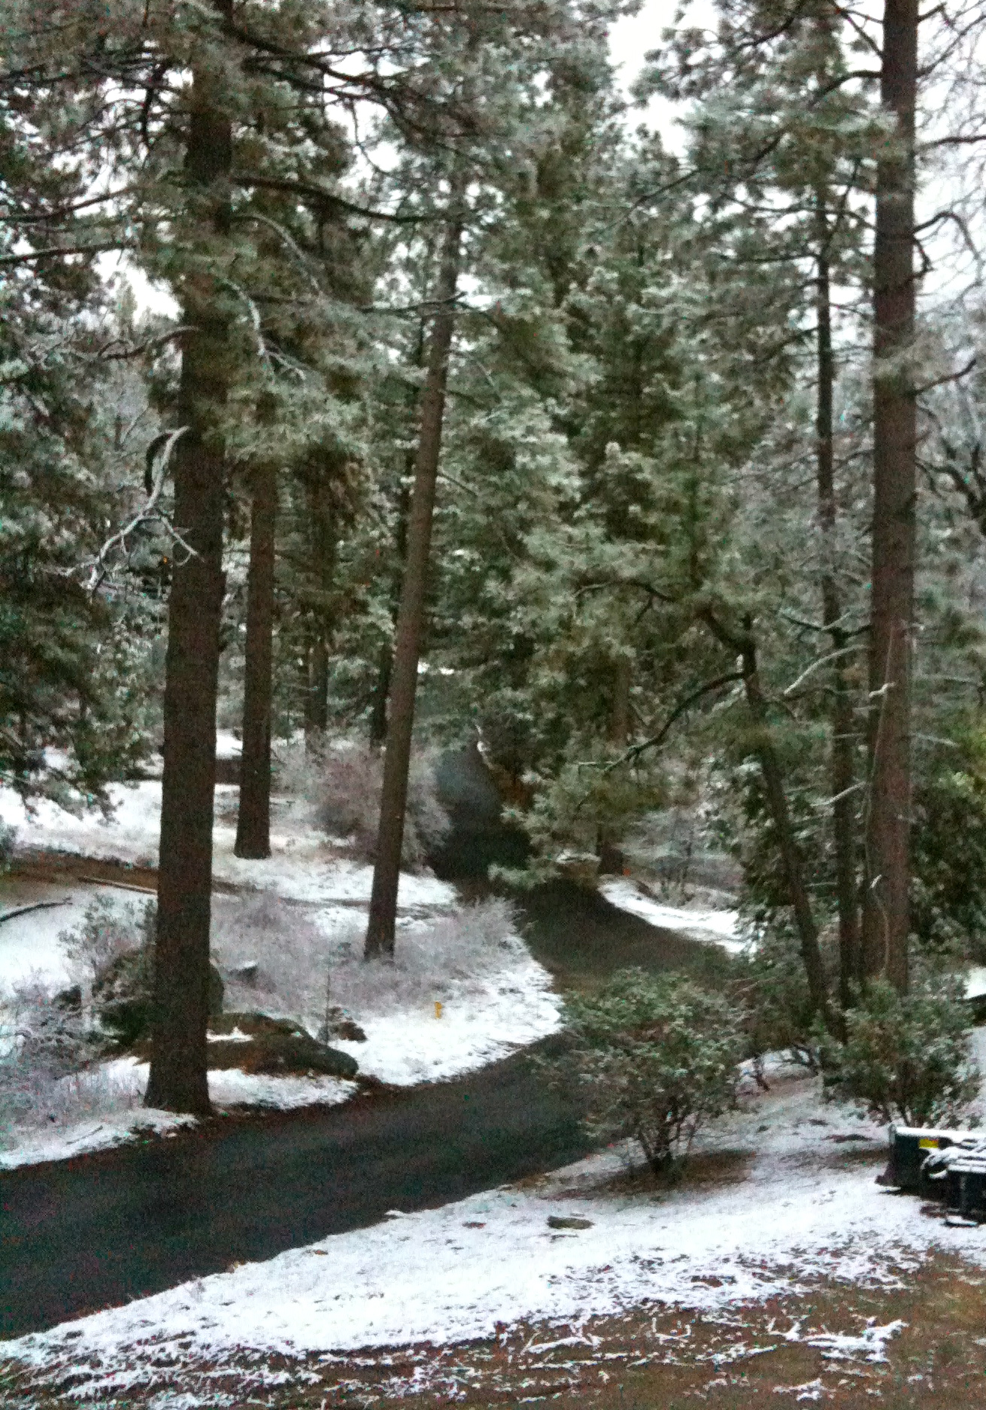
WHAT TO EXPECT
RULES
TLC Guidelines of Conduct will be reviewed at camp, on your first day.
Curfews are in place, and security is non site.
Emergency physician/nurses are on hand.
Find it clean & leave it clean.
No cell phone usage, texting or email. Pictures ok, only.

Slide 13
WHAT TO BRING
Sleeping bag, pillow, toiletries, bath towel, wash cloth
A warm jacket, hat, gloves and rain gear
Flashlight & batteries, travel alarm clock, lip balm, sunglasses, cheap camera, pen or pencil, day pack to carry your things.
Jeans, sweats or slacks, water resistant boots or shoes, warm sleepwear, long-sleeved shirts, changes of underwear.
Sweaters and/or sweatshirts, several pair of socks, flip flops or shower shoes. One TLC sweatshirt will be given to you at camp.
Pack all of your gear in a duffel bag or other suitable luggage that you can carry a far distance.
Also, bring a few large trash bags in which you can place your luggage, sleeping bag, pillow etc... in case of rain or snow.
A sense of humor and a great attitude!!

Slide 14
WHAT NOT TO BRING
Weapons of any kind
Alcohol or illegal drugs
Valuables of any kind
Cigarettes, matches or lighters
Laptops, tablet computers, video games, etc.
Formal attire/Swim clothes
School work – there is no time to complete it!

Slide 15
TLC INFO
YOUTH PROTECTION
District 5300 is committed to creating and maintaining the safest possible environment for all participants.
Procedures have been created to safeguard both our youth and adult members.
All Adults at TLC have gone through Youth Protection Training and an FBI Background Check.

Slide 16
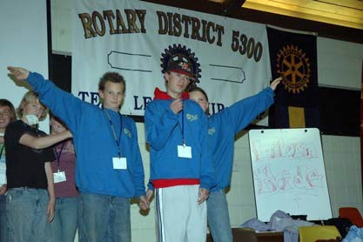
QUESTIONS?
Any questions feel free to contact TLC Chair,
Eric Threeton, Downtown Las Vegas Rotary
eric3ton@gmail.com
,
^{See you December 1st}

