Slide 1



Rotary International
District 5300
Dan Stover Music Contest

Slide 2
2024-25 Theme

Slide 3
Note from the
Dan Stover District Chair
The Dan Stover Music Award was started by the district to honor a beloved Rotarian from the Alhambra Club who encouraged music in Rotary. This award is meant to inspire young musicians, recognize their talent, and encourage them in their journey.
Last the contested featured some outstanding performers and performances from throughout the district. Since the District Convention is the first weekend in April, the registration must be completed by December 1, 2024 and the local contest must be completed by February 1, 2025. A calendar is included in this presentation to help with the time. If you need help, please contact me. I am more than happy to help. Send me and email or give me a call.
Blessings,
Brett O’Connor 909-721-6511
boconnor12@gmail.com

Slide 4
THE LEVELS
Clubs – (67)
Groups (14)
Regional (4)
District 5300

Slide 5
CLUB LEVEL
The contest begins at the club level
Each club will have a contest among the students from their area. Clubs may choose to combine and can register with the district as such. ($350 club in 2025)
Local clubs provide local award for winner.

Slide 6
CONTEST PROGRESSION
District 5300
California West
Group 2
Group 5
California East
Group 3
Group 4
Group 6
Group 7
Group 8
High Desert
Southern Nevada
Group 11
Group 14
Group 9
Group 12
Group 13
Group 1
Antelope Valley
Group 10

Slide 7

PRIZES!
Clubs Budget for Prize Money
Local – Group - Regional
District Prize based upon number of clubs that participate
2024-2025 – 15 Clubs ($4,500)
In Prize Money

Slide 8
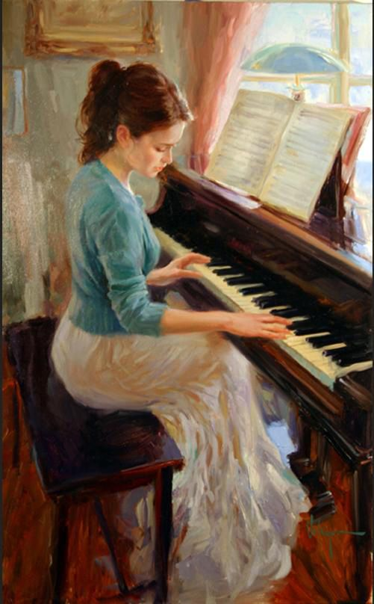
Club Level Contest
Local clubs host their own contest which may be combined with other clubs.
This is the only level where clubs hold competitions during their regularly scheduled weekly meetings
Local clubs provide prize money for their individual contest test.
Winner moves on to the Regional Contest

Slide 9
Regional Level Hosting
Club Music Chairs within the region may contact each other to determine location for Regional Contest. The District Coordinator will help with this
Local clubs should provide Regional prize and honorariums for the Judges

Slide 10
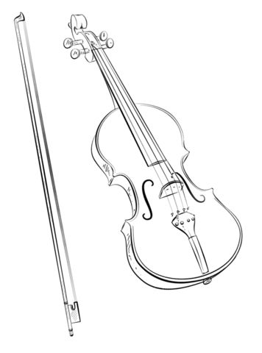
District Level Contest
District Chair will host the competition.
In 2025 the District Competition will be at the District Foundation Dinner on April 12, 2025.

Slide 11
HOST RESPONSIBILITIES
Contact
Meal
Students
Prizes
Judges
Club
District
Overseen by District Chair
Regional
Judges (not from clubs)
Gift card for judges
Winning contestant contact info to District Music Chair

Slide 12
PLACES
First Place
First Runner-Up
Runner-Up

Slide 13
Deadline for Registration
Dan Stover Music Contest Entry Deadline is December 1, 2024.
$350 per club. All money is to be sent to the District by January 10, 2025 (check for updated address)
Entry form to be completed on-line (no other forms will be accepted). A copy will be automatically sent to District Dan Stover Music Contest Chair Brett O’Connor
boconnor12@gmail.com

Slide 14
TIMELINE
Fall, 2024 - Pick a date in January for the Club contest
December– Contact Schools / Send Registration / Set Club Contest Date. Must be completed by February 1
January – Club Contest/ Send Winner info to District Coordinator
February-Group Contest Takes Place by Feb. 22
March– Regional Contest Takes Place by March 15
April 12 – Contestant to District Event

Slide 15

www.district5300.org
Once you’re in the website click on Service, then Youth Service then Dan Stover Music Contest This is what you will find
Contest Format
Club Entry Form now on DACDB calendar
Rules
Judging Form and Time Sheet
Sample Club Forms
PowerPoint Presentation
Certificates for Competition Winners
Club Level
Region Level

Slide 16
I’m here to help!
Brett o’Connor
2024-2025
District Dan Stover Music Contest Chair
909-721-6511
boconnor12@gmail.com

